Slide 1
IP Addressing II
Course Code: CSC 3116
Course Title: Computer Networks
Dept. of Computer Science
Faculty of Science and Technology
Lecturer No: | Lab 2 | Week No: | 2 | Semester:
Lecturer: | Fahad Khandoker

Slide 2
Lecture Outline
Classful Address
Network and Host Address
Broadcast

Slide 3
Classful Addressing
Address
  Class A
  Class B
  Class C
  Class D
  Class E

Slide 4
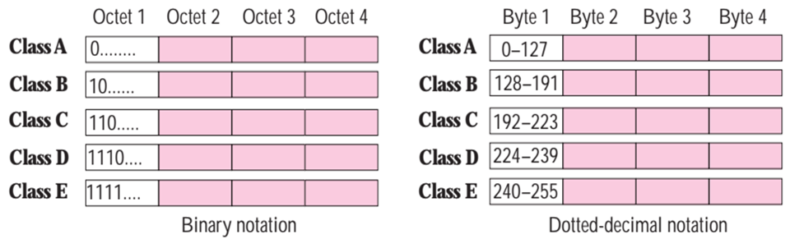
Recognizing Class

Slide 5
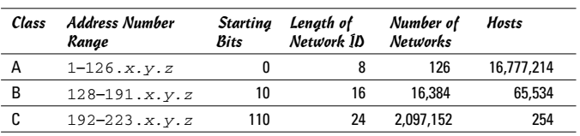
Recognizing Class (cont.…)

Slide 6
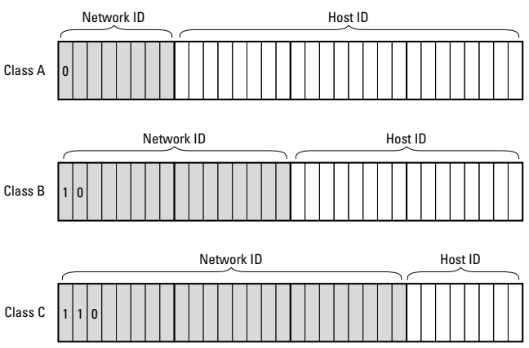
Network address and Host address (cont.…)
Network ID length: 8 bits
Host ID length: 24 bits
Network ID length: 16 bits
Host ID length: 16 bits
Network ID length: 24 bits
Host ID length: 8 bits

Slide 7
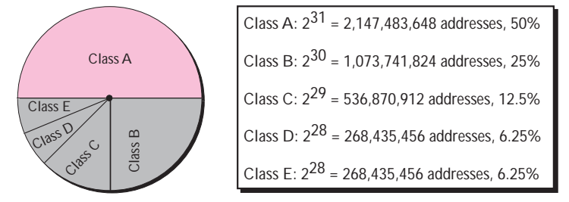
Address Space

Slide 8
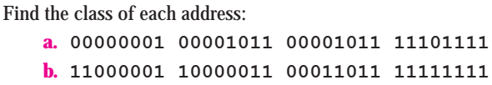

Address Space (cont.…)
Problem
Solution

Slide 9
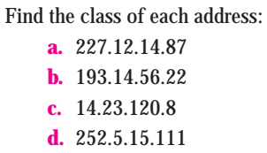
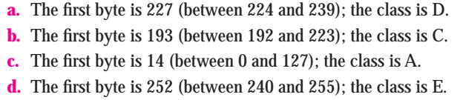
Address Space (cont.…)
Solution

Slide 10
Few of the special purpose IP addresses
IP address | Purpose
0.0.0.0 | For several reasons*
10.0.0.0 to 10.255.255.255, 8-bits mask | Private IP address
172.16.0.0 to 172.31.255.255, 12-bits mask | Private IP address
192.168.0.0 to 192.168.255.255, 16-bits mask | Private IP address
255.255.255.255 | Limited Broadcast IP address
127.0.0.0 | Loopback address
Automatically temporarily assigned to host for DHCP discovery
If a host has two IP addresses, 192.168.1.1 and 10.1.2.1, and a server running on the host is configured to listen on 0.0.0.0, it will be reachable at both of those IP addresses.

Slide 11
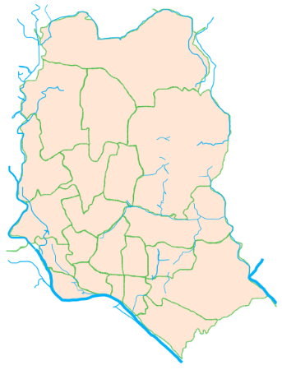
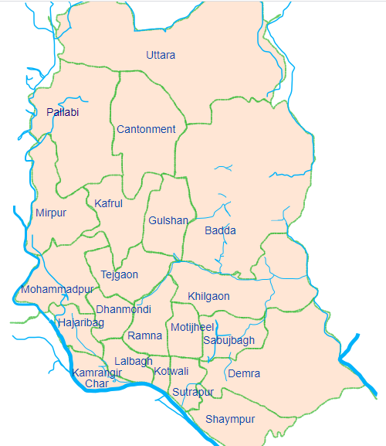
Network address and Host address
1230
1206
1216
1212
1207
1215
1219
1209

Slide 12
Network address and Host address (cont.…)
The network ID (or network address: Identifies the network on which a host computer can be found
The host ID (or host address): Identifies a specific device on the network indicated by the network ID
Analogy:
Network address------>Postcode of an area
Host address---------> House number of a person in that area

Slide 13

Network address and Host address (cont.…)
No. of Networks= $2^{No. of bits in the network ID }$
No. of hosts= $2^{No. of bits in the host ID}$-2

Slide 14
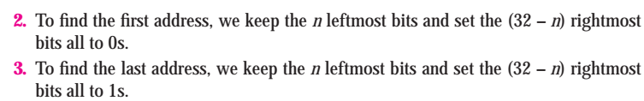
Extracting Information in a Block
How many addresses are there in a block?
What is the first address?
What is the last address?

Slide 15
Broadcast
Broadcast¹
  Sending packet to all hosts of a network
  Limited Broadcast
    When a host of a network sends packet to all hosts of the same network
    Sends packet to 255.255.255.255 IP address
  Direct Broadcast
    When a host of a network sends packet to all hosts of another network.
    If the network address of the target network is 20.0.0.0, the packet is sent to 20.255.255.255
1 E. Conrad, S. Misenar and J. Feldman, CISSP Study Guide, 3rd ed., Elsevier Inc., 2016

Slide 16
Broadcast
A network has three kinds of IP addresses
  Network IP address
    Lowest IP address of the network
  Broadcast IP address
    Highest IP address of the network
  Host IP addresses
    All IP addresses of the network except the lowest and highest IP address

Slide 17
Broadcast
How to get network IP address and broadcast IP address?
  Network IP address: Replace all host bits by zeroes (0) of any IP address of the network
  Broadcast IP address: Replace all host bits by ones of any IP address of the network

Slide 18
Broadcast
What is the network and broadcast IP addresses of the network which uses 192.100.12.110 as a host address?
  192.100.12.110 is a class C address
  192.100.12 is the network part and 110 is the host part
  Network IP address: 192.100.12.0
  Broadcast IP address: 192.100.12.255
No. of usable host IP address: No. of addresses-2

Slide 19
Broadcast
Find the network and broadcast IP addresses of the network which uses the followings as host address
  172.10.12.10
  204.130.120.10
  100.13.10.1
  10.5.3.5
  192.168.10.15
  Find the range of hosts of each network as well.

Slide 20
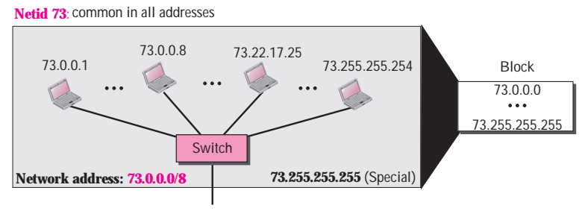
Network Design
Example
An address in a block is given as 73.22.17.25. Find the number of addresses in the block, the first address, and the last address.
Number of bits in Netid

Slide 21
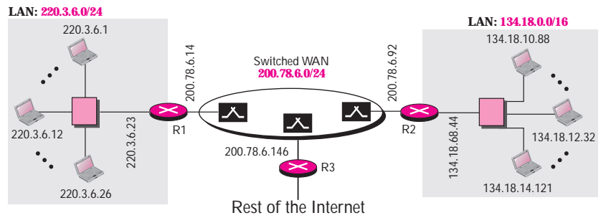
Interconnections of multiple networks

Slide 22
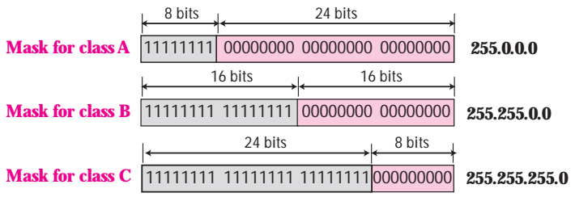
Network Mask/Subnet Mask
A network mask or a default mask in classful addressing is a 32-bit number with n leftmost bits all set to 1s and (32 - n) rightmost bits all set to 0s

Slide 23
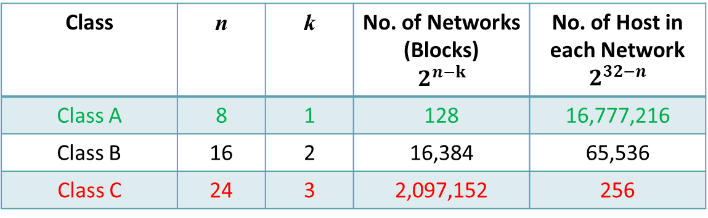
Network Mask/Subnet Mask
Huge wastage of IP addresses
Class | n | k | No. of Networks (Blocks) $$2^{n−k}$$ | No. of Host in each Network $$2^{32−n}$$
Class A | 8 | 1 | 128 | 16,777,216
Class B | 16 | 2 | 16,384 | 65,536
Class C | 24 | 3 | 2,097,152 | 256
Wastage of IP addresses
No enough for all
organizations

Slide 24
References
  1. Official Cert Guide CCNA 200-301 , vol. 1, W. Odom, Cisco Press, First Edition, 2019, USA.
  2. CCNA Routing and Switching, T. Lammle, John Wily & Sons, Second Edition, 2016, USA.
  3. Cisco IOS Configuration Fundamentals Command Reference.
  http://www.cisco.com

Slide 25
Books
  1. Official Cert Guide CCNA 200-301 , vol. 1, W. Odom, Cisco Press, First Edition, 2019, USA.
  2. CCNA Routing and Switching, T. Lammle, John Wily & Sons, Second Edition, 2016, USA.

